Slide 1
FINAL PROJECT
ALY6010 - Probability Theory and Introductory Statistics
Instructor: Prof. Amin Karimpour
Date: December 2021
By,
Jeseeka Shah,
Sanjana Chaudhari &
Supreeth Murugesh

Slide 2
Project Pathway
Cleaning and Selection of Data
Statistical Analysis
Regression & Correlation
Selecting Dataset
Exploratory Data Analytics

Slide 3

Supermarket store is the chain of stores present globally and our analysis considers only US Market orders.
The dataset has 512,900 orders and after filtering the orders are only 9,994.
Number of variables present are 24 which comprises of character, numerical and date formats.
Additionally, a new calculated variable total sale was obtained by product of quantity of sale and price of the item ordered.

Slide 4
Exploratory Data Analytics
1. Which category had the highest orders placed?
2. What’s the preferred shipping mode of customers?
3. How does the profit trends varies per categories?

Slide 5
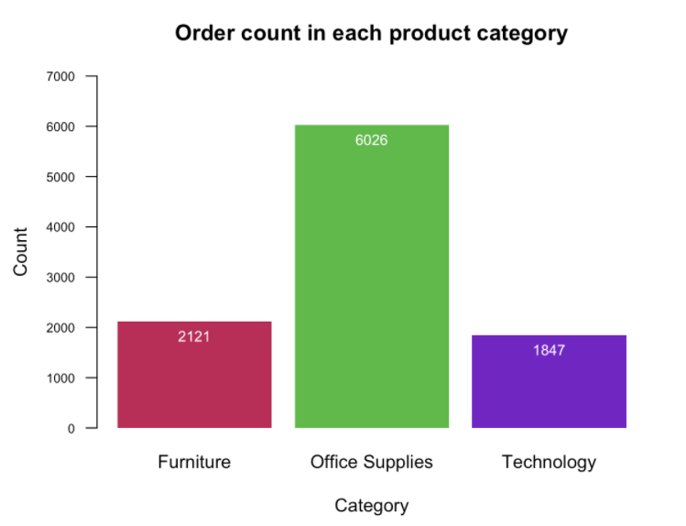
Which category had the highest orders placed?
Office supplies recorded the highest orders compared to other categories.

Slide 6
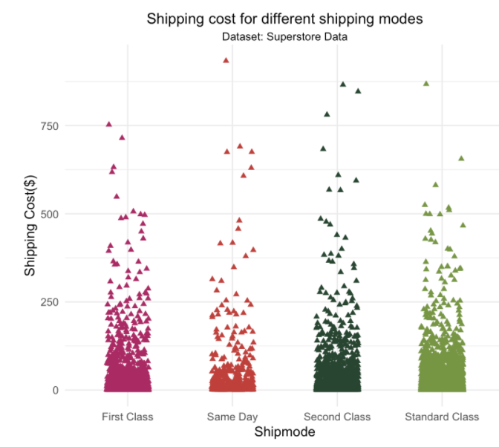
What’s the preferred shipping mode of Customers?

Slide 7
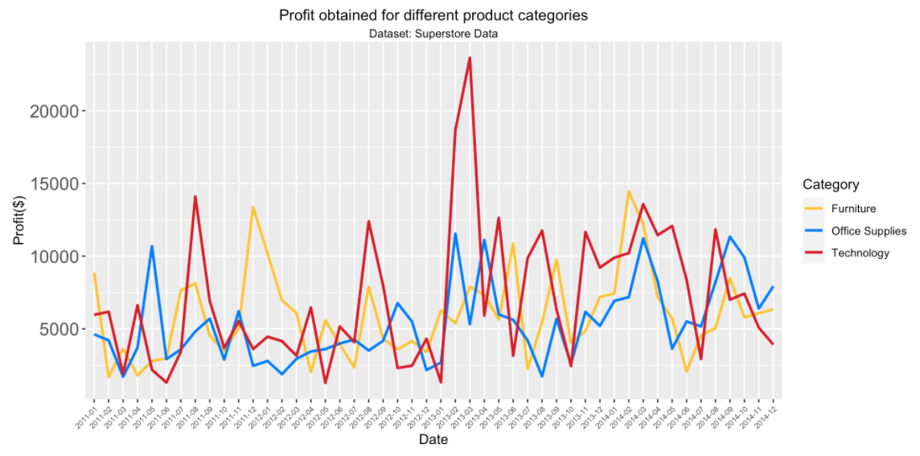
Profit trends for different category

Slide 8
Statistical Analytics
Is company’s average profit $25 ?
Is the average shipping cost for Consumer and Corporate segments same?
Does the company have higher average sales in the East region than that of the West region of the US?
Is the average profit earned by the company in the category office supplier and technology equal?

Slide 9
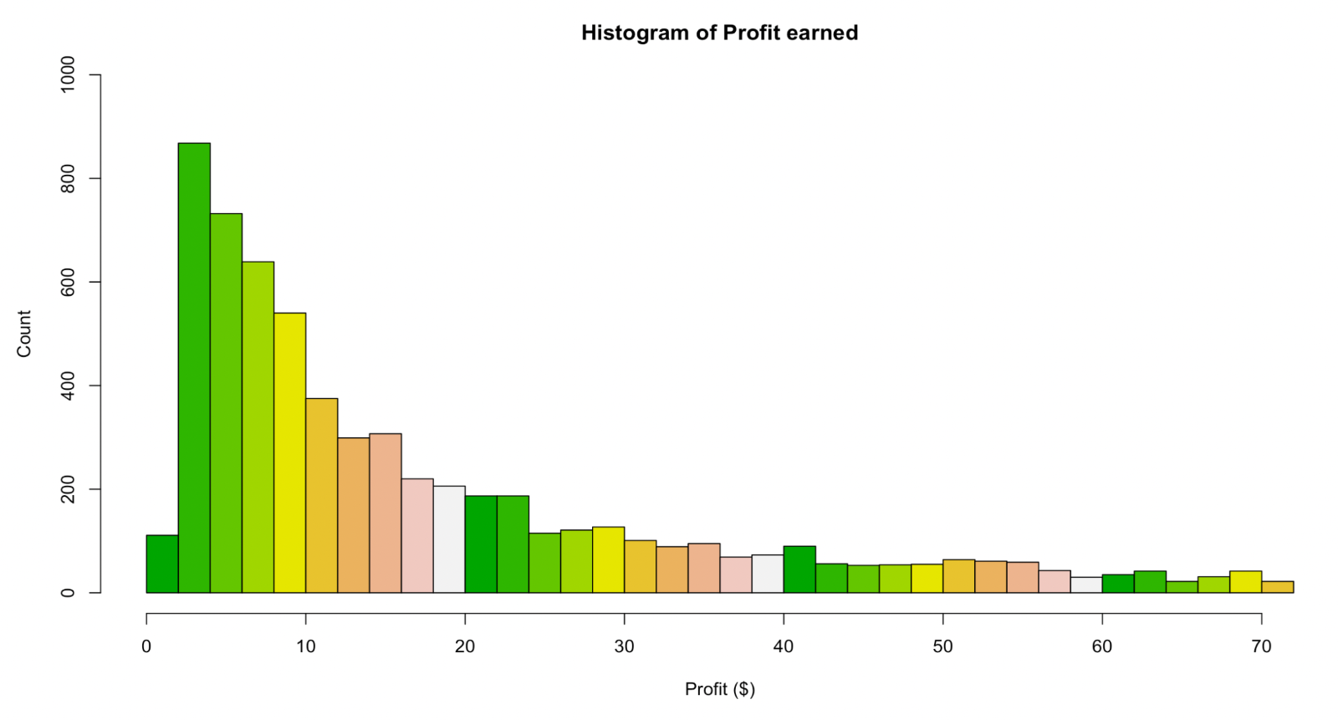
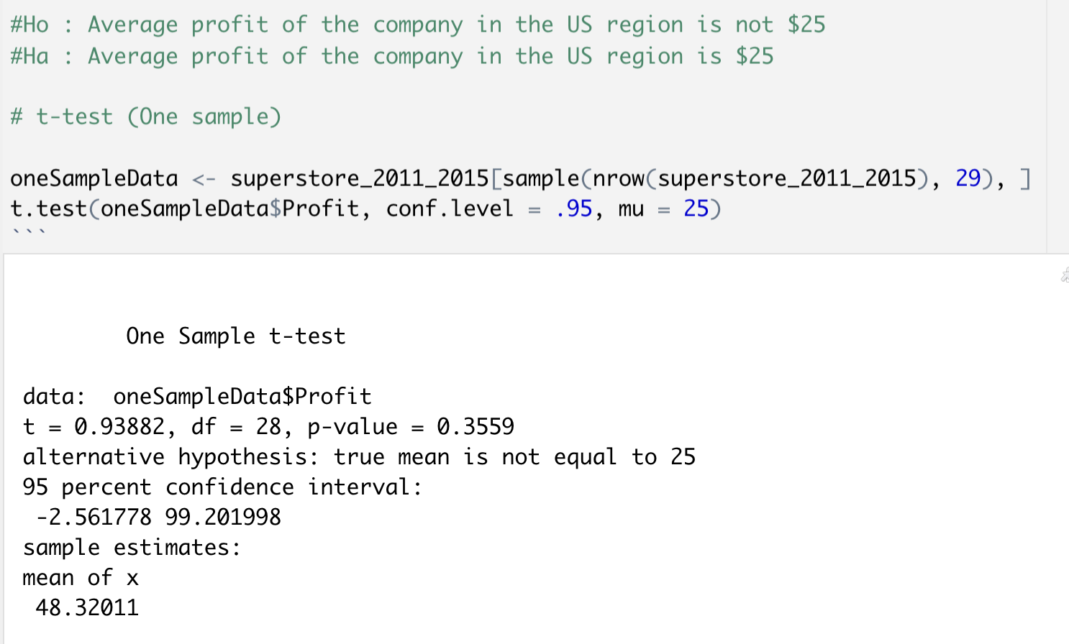
Is companies average profit $25?

Slide 10
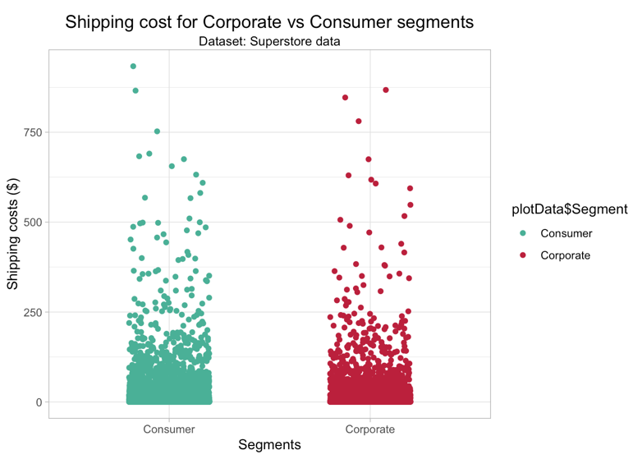
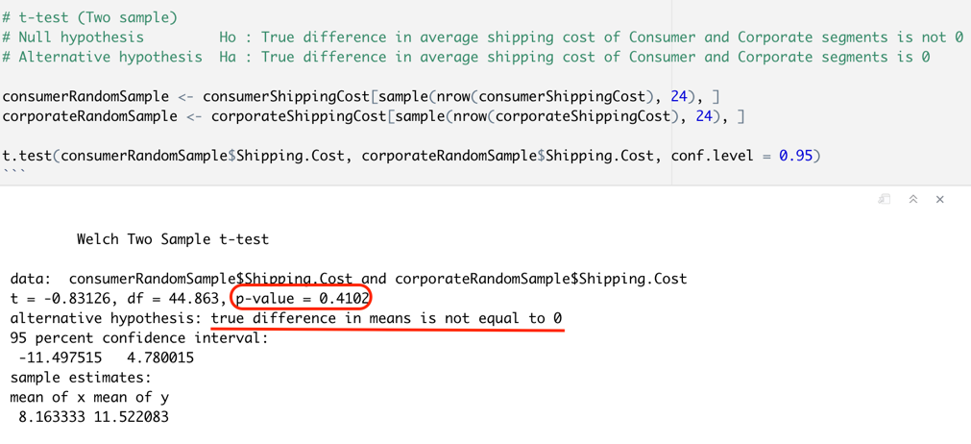
Is the average shipping cost for Consumer and Corporate segments same?

Slide 11
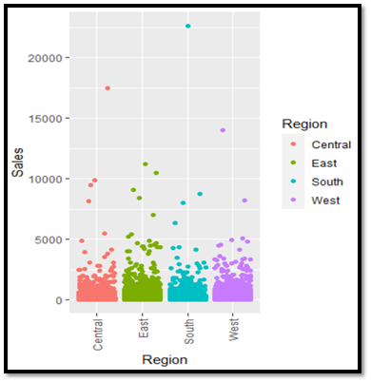
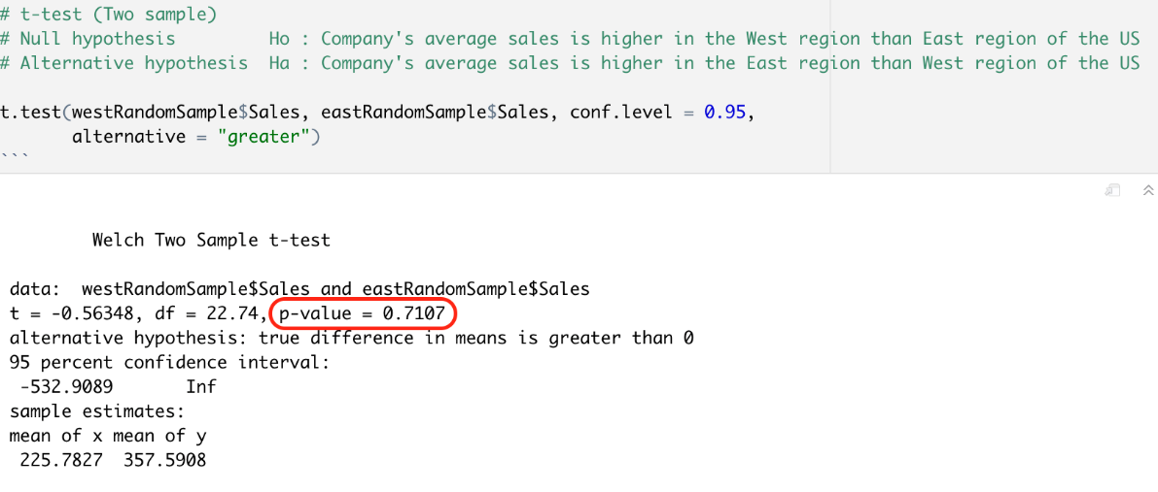
Does the company have higher average sales in the East region than that of the West region of the US?

Slide 12
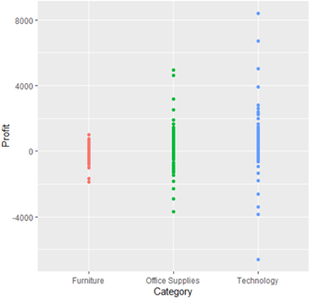
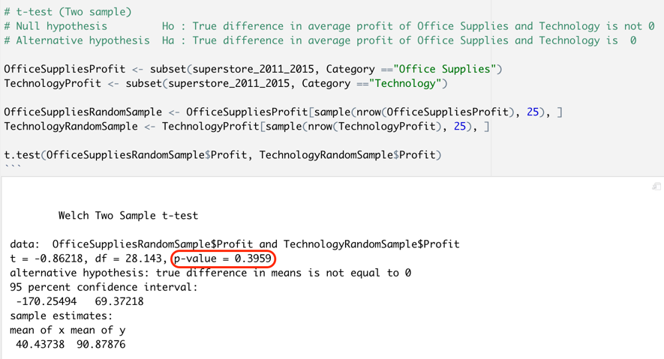
Is the average profit earned by the company in the category office supplier and technology equal?

Slide 13
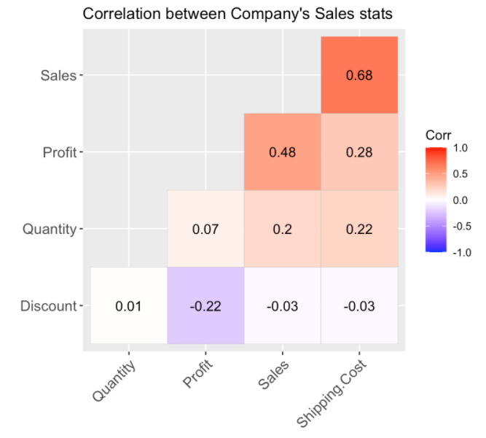
Correlation and Regression analysis
Sales and Shipping cost : Strong positive correction as its very close to 1.
Profit and Sales : Moderate correlation as it is close to 0.5
Discount vs Profit : Weak negative correlation
Quantity and other all factors : Weak correlations with all.

Slide 14
Shipping cost VS Sales per customer categories

Slide 15
Summary
We have answered a few questions regarding sale of the company in the US region from 2011 to 2014.
Sales of US market based on the region(East, West, Central, South)
Total order counts received for each categories.
Profit gained per quantity of sold items for different segments.
Shipping mode preferred by customers and its association with total sales made.
Profit trend per category of the company.
Profit and Sales hypotheses for various segments and categories of items sold by the company.

Slide 16

Thank you

